Slide 1


HEART
Accuracy Analysis of applied
Classification Models on
Failure
Prediction
Dataset
Himanshu Gadge 17CO013
Prateek Kachare 17CO022
Sudarshan Madane 17CO031
Vaibhav Tode 16CO063

Slide 2
Problem Statement
To predict/classify the death events i.e. yes/no based on other attributes in a dataset created using various classification models and to find accuracy for each classification model and making analysis which classification is better (finding the right classification model).

Slide 3
Introduction
Classification is an important task in day to day life. In this project, we have analysed the performance of various classifiers like Naïve Bayes, K-nearest neighbor, Rule Induction, Decision Tree, Random Forest. These classifiers are checked against “Heart Failure Prediction” dataset. This project is carried out in the Rapidminer.

Slide 4
Objective
To apply various classification models and based on the result, it can predict/classify the death events i.e. yes/no.
To find Right classification Model.

Slide 5
Approach
In this project, we are applying following 5 Classification models and finding accuracy/performance for each classifier:
Naïve Bayes
K-nearest neighbor
Rule Induction
Decision Tree
Random Forest
Based on accuracy of each model, we are identifying the best classification model.

Slide 6
What is RapidMiner?
RapidMiner is a data science software platform developed by the company of the same name that provides an integrated environment for data preparation, machine learning, text mining, and predictive analytics.
Key Features of RapidMiner:
Application & Interface
Data Access
Data Exploration
Data Preparation
Modeling
Validation
Scoring
Code Control

Slide 7
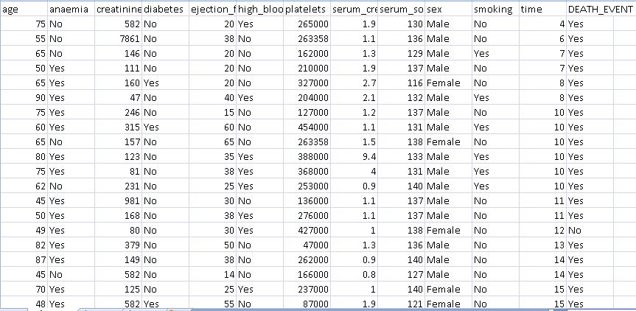
Dataset
The Heart Failure Prediction dataset with 299 examples and 13 attributes as follows:

Slide 8
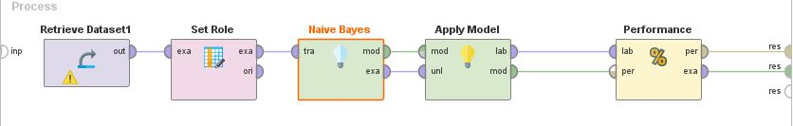
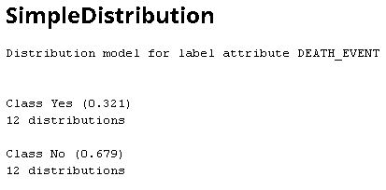
Naïve Bayes
Result

Slide 9
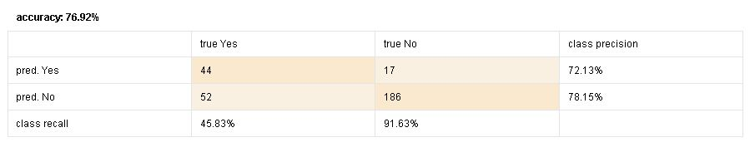
Performance

Slide 10
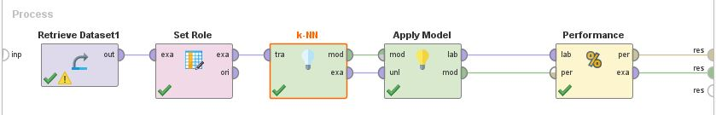
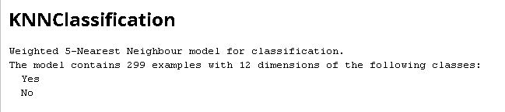
KNN
Result

Slide 11
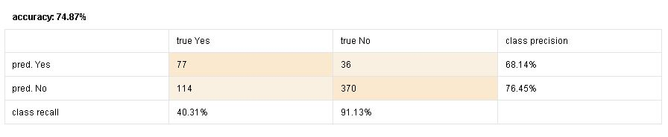
Performance

Slide 12
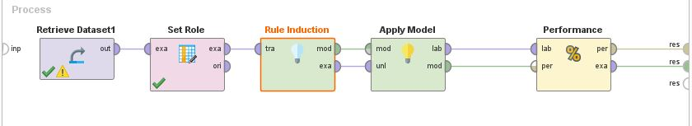
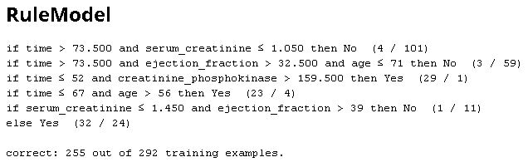
Rule Induction
Result

Slide 13
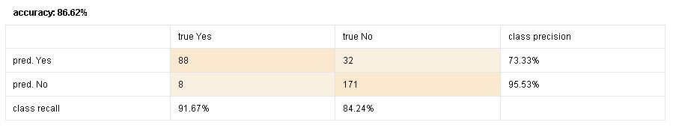
Performance

Slide 14
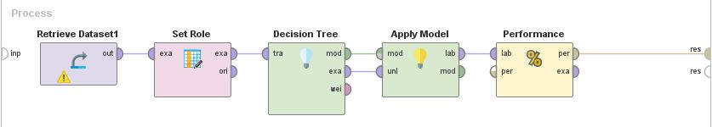
Decision Tree

Slide 15
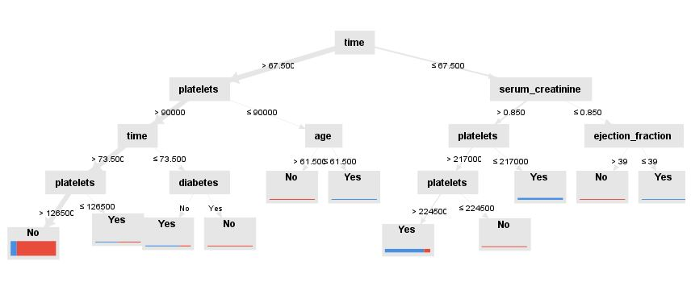
Result

Slide 16
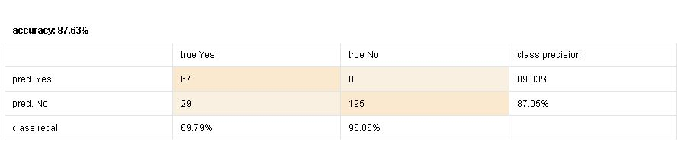
Performance

Slide 17
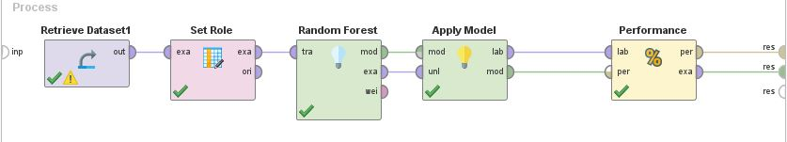
Random Forest

Slide 18
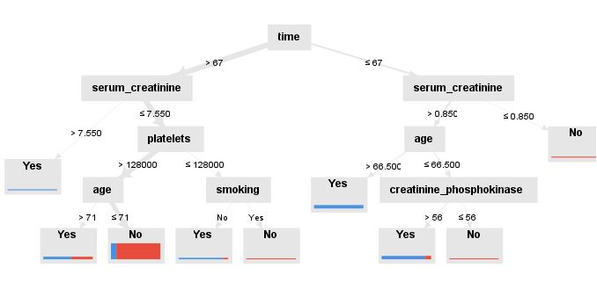
Result

Slide 19
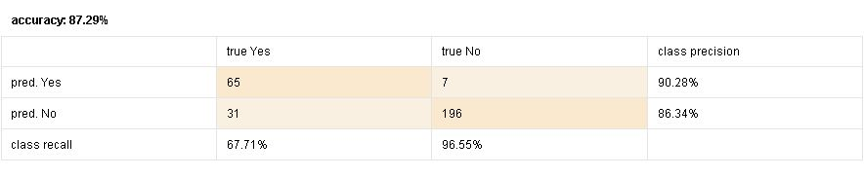
Performance

Slide 20
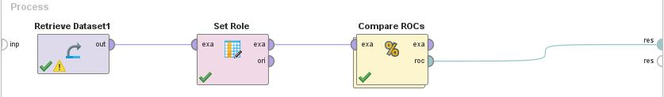
Compare ROC(Receiver Operating Characteristic)

Slide 21
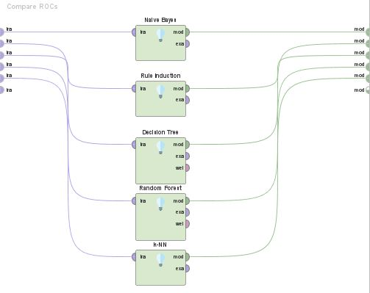

Slide 22
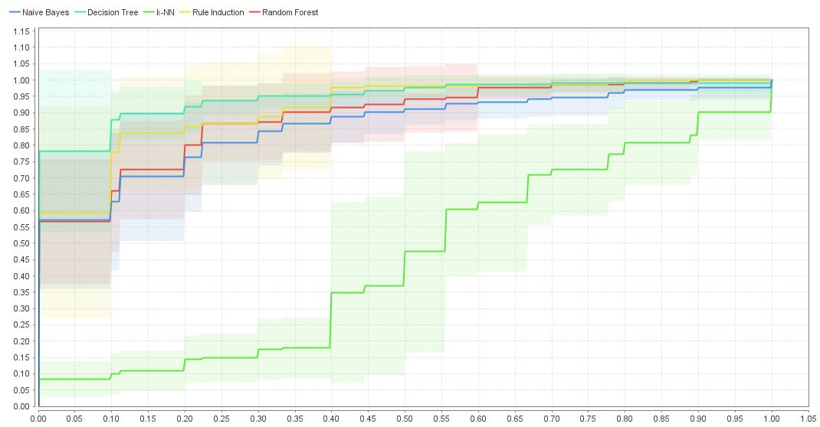
Result

Slide 23
Accuracy Table
Sr. No. | Classification Model | Accuracy
1 | Naïve Bayes | 76.92%
2 | KNN | 74.87%
3 | Rule Induction | 86.62%
4 | Decision Tree | 87.63%
5 | Random Forest | 87.29%

Slide 24
Conclusion
Using Rapidminer , we have applied 5 classification models such as Naïve Bayes, KNN, Rule Induction, Decision Tree, Random Forest among these Decision tree gives highest accuracy (87.29%) and KNN gives least accuracy (74.87%).

Slide 25


Thank You! Stay Healthy
Stay Fit

